Slide 1
CHEMICAL SHIFT

Slide 2
PEAKS ARE MEASURED RELATIVE TO TMS
Rather than measure the exact resonance position of a
peak, we measure how far downfield it is shifted from TMS.
reference compound
tetramethylsilane
“TMS”
Highly shielded
protons appear
way upfield.
TMS
Chemists originally
thought no other
compound would
come at a higher
field than TMS.
shift in Hz
downfield
n
0

Slide 3
DESHIELDING BY
ELECTRONEGATIVE ELEMENTS

Slide 4
DESHIELDING BY AN ELECTRONEGATIVE ELEMENT
δ-
δ+
Chlorine “deshields” the proton,
that is, it takes valence electron
density away from carbon, which
in turn takes more density from
hydrogen deshielding the proton.
Cl
C
H
δ-
δ+
electronegative
element
NMR CHART
“deshielded“
protons appear
at low field
highly shielded
protons appear
at high field
deshielding moves proton
resonance to lower field

Slide 5
Electronegativity Dependence of Chemical Shift
Dependence of the Chemical Shift of CH₃X on the Element X
Compound CH₃X
CH₃F CH₃OH CH₃Cl CH₃Br CH₃I CH₄ (CH₃)₄Si
Element X
F O Cl Br I H Si
Electronegativity of X
4.0 3.5 3.1 2.8 2.5 2.1 1.8
Chemical shift δ
4.26 3.40 3.05 2.68 2.16 0.23 0
most
deshielded
TMS
deshielding increases with the
electronegativity of atom X

Slide 6
Substitution Effects on Chemical Shift
most
deshielded
The effect
increases with
greater numbers
of electronegative
atoms.
CHCl₃ CH₂Cl₂ CH₃Cl
7.27 5.30 3.05 ppm
most
deshielded
-CH₂-Br -CH₂-CH₂Br -CH₂-CH₂CH₂Br
3.30 1.69 1.25 ppm
The effect decreases
with incresing distance.

Slide 7
SPIN-SPIN SPLITTING

Slide 8
SPIN-SPIN SPLITTING
Often a group of hydrogens will appear as a multiplet
rather than as a single peak.
Multiplets are named as follows:
Singlet Quintet
Doublet Septet
Triplet Octet
Quartet Nonet
This happens because of interaction with neighboring
hydrogens and is called
SPIN-SPIN SPLITTING.

Slide 9
n + 1 RULE

Slide 10
this hydrogen’s peak
is split by its two neighbors
these hydrogens are
split by their single
neighbor
MULTIPLETS
singlet
doublet
triplet
quartet
quintet
sextet
septet
two neighbors
n+1 = 3
triplet
one neighbor
n+1 = 2
doublet

Slide 11
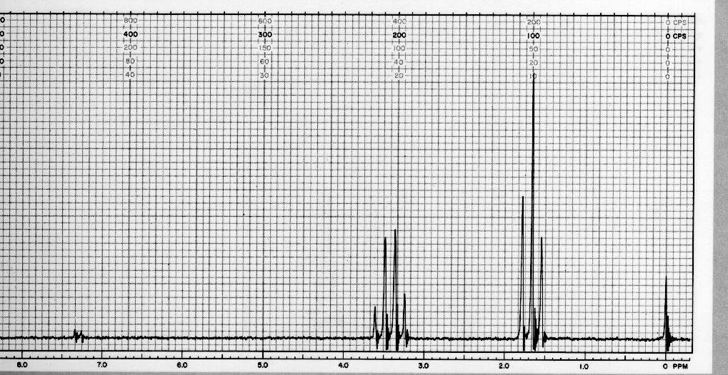
NMR Spectrum of Bromoethane

Slide 12
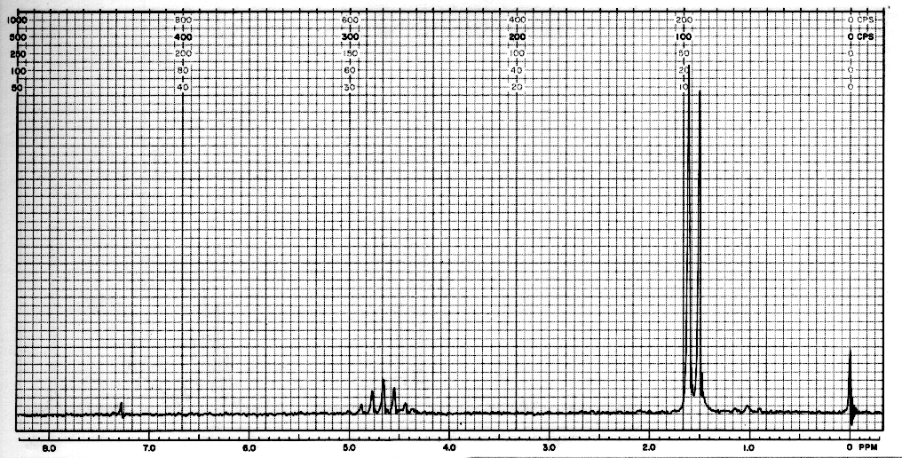
NMR Spectrum of 2-Nitropropane
1:6:15:20:16:6:1
in higher multiplets the outer peaks
are often nearly lost in the baseline

